Slide 1
Unit Commitment

Slide 2
Economic Dispatch: Problem Definition
Given load
Given set of units on-line
How much should each unit generate to meet this load at minimum cost?
A
B
C
L

Slide 3
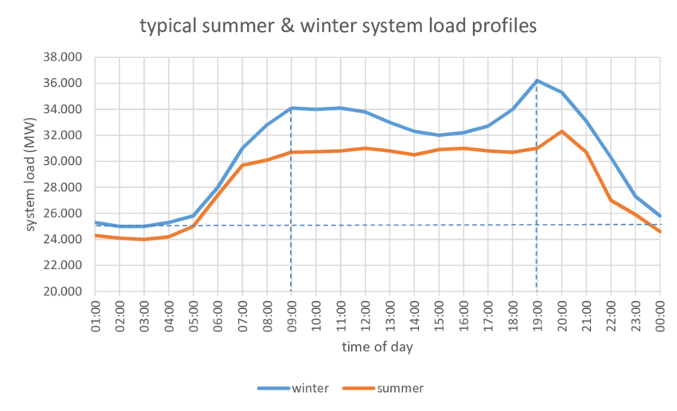
Typical summer and winter loads

Slide 4
Unit Commitment
Given load profile (e.g. values of the load for each hour of a day)
Given set of units available
When should each unit be started, stopped and how much should it generate to meet the load at minimum cost?
?
?
?
G
G
G
Load Profile

Slide 5
A Simple Example
Unit 1:
P_{Min} = 250 MW, P_{Max} = 600 MW
C₁ = 510.0 + 7.9 P₁ + 0.00172 P₁² $/h
Unit 2:
P_{Min} = 200 MW, P_{Max} = 400 MW
C₂ = 310.0 + 7.85 P₂ + 0.00194 P₂² $/h
Unit 3:
P_{Min} = 150 MW, P_{Max} = 500 MW
C₃ = 78.0 + 9.56 P₃ + 0.00694 P₃² $/h
What combination of units 1, 2 and 3 will produce 550 MW at minimum cost?
How much should each unit in that combination generate?

Slide 6
Cost of the various combinations

Slide 7
Observations on the example:
Far too few units committed: Can’t meet the demand
Not enough units committed: Some units operate above optimum
Too many units committed: Some units below optimum
Far too many units committed: Minimum generation exceeds demand
No-load cost affects choice of optimal combination

Slide 8
A more ambitious example
Optimal generation schedule for a load profile
Decompose the profile into a set of period
Assume load is constant over each period
For each time period, which units should be committed to generate at minimum cost during that period?
Load
1000
500
Time
0
6
12
18
24

Slide 9
Optimal combination for each hour

Slide 10
Matching the combinations to the load
Load
Unit 3
Unit 2
Unit 1
Time
0
6
12
18
24

Slide 11
Issues
Must consider constraints
Unit constraints
System constraints
Some constraints create a link between periods
Start-up costs
Cost incurred when we start a generating unit
Different units have different start-up costs
Curse of dimensionality

Slide 12
Unit Constraints
Constraints that affect each unit individually:
Maximum generating capacity
Minimum stable generation
Minimum “up time”
Minimum “down time”
Ramp rate

Slide 13
Notations
Status of unit i at period t
Unit i is on during period t
Unit i is off during period t
Power produced by unit i during period t

Slide 14
Minimum up- and down-time
Minimum up time
Once a unit is running it may not be shut down immediately:
Minimum down time
Once a unit is shut down, it may not be started immediately

Slide 15
Ramp rates
Maximum ramp rates
To avoid damaging the turbine, the electrical output of a unit cannot change by more than a certain amount over a period of time:
Maximum ramp up rate constraint:
Maximum ramp down rate constraint:

Slide 16
System Constraints
Constraints that affect more than one unit
Load/generation balance
Reserve generation capacity
Emission constraints
Network constraints

Slide 17
Load/Generation Balance Constraint

Slide 18
Reserve Capacity Constraint
Unanticipated loss of a generating unit or an interconnection causes unacceptable frequency drop if not corrected rapidly
Need to increase production from other units to keep frequency drop within acceptable limits
Rapid increase in production only possible if committed units are not all operating at their maximum capacity

Slide 19
How much reserve?
Protect the system against “credible outages”
Deterministic criteria:
Capacity of largest unit or interconnection
Percentage of peak load
Probabilistic criteria:
Takes into account the number and size of the committed units as well as their outage rate

Slide 20
Types of Reserve
Spinning reserve
Primary
Quick response for a short time
Secondary
Slower response for a longer time
Tertiary reserve
Replace primary and secondary reserve to protect against another outage
Provided by units that can start quickly (e.g. open cycle gas turbines)
Also called scheduled or off-line reserve

Slide 21
Cost of Reserve
Reserve has a cost even when it is not called
More units scheduled than required
Units not operated at their maximum efficiency
Extra start up costs
Must build units capable of rapid response
Cost of reserve proportionally larger in small systems
Important driver for the creation of interconnections between systems

Slide 22
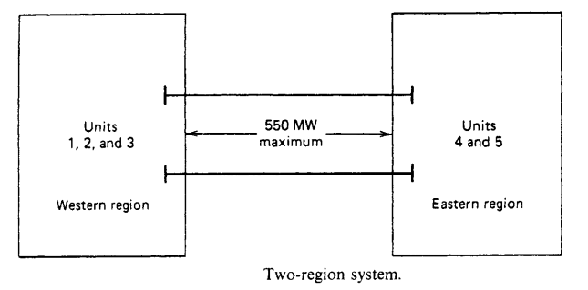
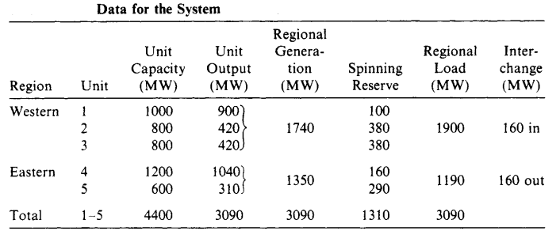

Example
4th Unit Out

Slide 23
Environmental constraints
Scheduling of generating units may be affected by environmental constraints
Constraints on pollutants such SO₂, NO_{x}
Various forms:
Limit on each plant at each hour
Limit on plant over a year
Limit on a group of plants over a year
Constraints on hydro generation
Protection of wildlife
Navigation, recreation

Slide 24
Network Constraints
Transmission network may have an effect on the commitment of units
Some units must run to provide voltage support
The output of some units may be limited because their output would exceed the transmission capacity of the network
A
B
Cheap generators
May be “constrained off”
More expensive generator
May be “constrained on”

Slide 25

Start-up Costs
Thermal units must be “warmed up” before they can be brought on-line
Warming up a unit costs money
$$C×t×F+∝_{i^{}}$$
Start-up cost depends on time unit has been off
α_{i} + β_{i}
α_{i}
t_{i}^{OFF}

Slide 26
Start-up Costs
Need to “balance” start-up costs and running costs
Example:
Diesel generator: low start-up cost, high running cost
Coal plant: high start-up cost, low running cost
Issues:
How long should a unit run to “recover” its start-up cost?
Start-up one more large unit or a diesel generator to cover the peak?
Shutdown one more unit at night or run several units part-loaded?

Slide 27
Summary
Some constraints link periods together
Minimizing the total cost (start-up + running) must be done over the whole period of study
Generation scheduling or unit commitment is a more general problem than economic dispatch
Economic dispatch is a sub-problem of generation scheduling

Slide 28
Flexible Plants
Power output can be adjusted (within limits)
Examples:
Coal-fired
Oil-fired
Open cycle gas turbines
Combined cycle gas turbines
Hydro plants with storage
Status and power output can be optimized
Thermal units

Slide 29
Inflexible Plants
Power output cannot be adjusted for technical or commercial reasons
Examples:
Nuclear
Run-of-the-river hydro
Renewables (wind, solar,…)
Combined heat and power (CHP, cogeneration)
Output treated as given when optimizing

Slide 30
Solving the Unit Commitment Problem
Decision variables:
Status of each unit at each period:
Output of each unit at each period:
Combination of integer and continuous variables

Slide 31
How many combinations are there?
Examples
3 units: 8 possible states
N units: 2^{N} possible states
111
110
101
100
011
010
001
000

Slide 32
How many solutions are there anyway?
Optimization over a time horizon divided into intervals
A solution is a path linking one combination at each interval
How many such paths are there?
T=
1
2
3
4
5
6

Slide 33
How many solutions are there anyway?
Optimization over a time horizon divided into intervals
A solution is a path linking one combination at each interval
How many such path are there?
Answer:
T=
1
2
3
4
5
6

Slide 34
The Curse of Dimensionality
Example: 5 units, 24 hours
Processing 10⁹ combinations/second, this would take 1.9 10¹⁹ years to solve
There are 100’s of units in large power systems...
Many of these combinations do not satisfy the constraints

Slide 35
How do you Beat the Curse?
Brute force approach won’t work!
Need to be smart
Try only a small subset of all combinations
Can’t guarantee optimality of the solution
Try to get as close as possible within a reasonable amount of time

Slide 36
Main Solution Techniques
Characteristics of a good technique
Solution close to the optimum
Reasonable computing time
Ability to model constraints
Priority list / heuristic approach
Dynamic programming
Lagrangian relaxation

Slide 37
A Simple Unit Commitment Example

Slide 38
Unit Data
Unit | P_{min} (MW) | P_{max} (MW) | Min up (h) | Min down (h) | No-load cost ($) | Marginal cost ($/MWh) | Start-up cost ($) | Initial status
A | 150 | 250 | 3 | 3 | 0 | 10 | 1,000 | ON
B | 50 | 100 | 2 | 1 | 0 | 12 | 600 | OFF
C | 10 | 50 | 1 | 1 | 0 | 20 | 100 | OFF

Slide 39
Demand Data
Reserve requirements are not considered

Slide 40
Feasible Unit Combinations (states)
Combinations |  |  | P_{min} | P_{max}
A | B | C
1 | 1 | 1 | 210 | 400
1 | 1 | 0 | 200 | 350
1 | 0 | 1 | 160 | 300
1 | 0 | 0 | 150 | 250
0 | 1 | 1 | 60 | 150
0 | 1 | 0 | 50 | 100
0 | 0 | 1 | 10 | 50
0 | 0 | 0 | 0 | 0
 | 1 | 2 | 3
 | 150 | 300 | 200

Slide 41
Transitions between feasible combinations
A | B | C
1 | 1 | 1
1 | 1 | 0
1 | 0 | 1
1 | 0 | 0
0 | 1 | 1
 | 1 | 2 | 3
Initial State

Slide 42
Infeasible transitions: Minimum down time of unit A
A | B | C
1 | 1 | 1
1 | 1 | 0
1 | 0 | 1
1 | 0 | 0
0 | 1 | 1
 | 1 | 2 | 3
Initial State
 | T_{D} | T_{U}
A | 3 | 3
B | 1 | 2
C | 1 | 1

Slide 43
Infeasible transitions: Minimum up time of unit B
A | B | C
1 | 1 | 1
1 | 1 | 0
1 | 0 | 1
1 | 0 | 0
0 | 1 | 1
 | 1 | 2 | 3
Initial State
 | T_{D} | T_{U}
A | 3 | 3
B | 1 | 2
C | 1 | 1

Slide 44
Feasible transitions
A | B | C
1 | 1 | 1
1 | 1 | 0
1 | 0 | 1
1 | 0 | 0
0 | 1 | 1
 | 1 | 2 | 3
Initial State

Slide 45
Operating costs
1 | 1 | 1
1 | 1 | 0
1 | 0 | 1
1 | 0 | 0
4
3
7
2
6
1
5

Slide 46
Economic dispatch
State | Load | P_{A} | P_{B} | P_{C} | Cost
1 | 150 | 150 | 0 | 0 | 1500
2 | 300 | 250 | 0 | 50 | 3500
3 | 300 | 250 | 50 | 0 | 3100
4 | 300 | 240 | 50 | 10 | 3200
5 | 200 | 200 | 0 | 0 | 2000
6 | 200 | 190 | 0 | 10 | 2100
7 | 200 | 150 | 50 | 0 | 2100
Unit | P_{min} | P_{max} | No-load cost | Marginal cost
A | 150 | 250 | 0 | 10
B | 50 | 100 | 0 | 12
C | 10 | 50 | 0 | 20

Slide 47
Operating costs
1 | 1 | 1
1 | 1 | 0
1 | 0 | 1
1 | 0 | 0
4
$3200
3
7
$3100
$2100
2
6
$3500
$2100
1
5
$1500
$2000

Slide 48
Start-up costs
1 | 1 | 1
1 | 1 | 0
1 | 0 | 1
1 | 0 | 0
4
$3200
$0
$700
3
$0
7
$3100
$2100
$600
$600
2
$0
6
$3500
$2100
$100
$0
$0
1
5
$1500
$2000
Unit | Start-up cost
A | 1000
B | 600
C | 100

Slide 49
Accumulated costs
1 | 1 | 1
1 | 1 | 0
1 | 0 | 1
1 | 0 | 0
$5400
4
$3200
$0
$7300
$5200
$700
3
$0
7
$3100
$2100
$5100
$600
$7200
$600
2
$0
6
$3500
$2100
$100
$0
$1500
$7100
$0
1
5
$1500
$2000

Slide 50
Total costs
1 | 1 | 1
1 | 1 | 0
1 | 0 | 1
1 | 0 | 0
4
$7300
3
7
$7200
2
6
$7100
1
5
Lowest total cost

Slide 51
Optimal solution
1 | 1 | 1
1 | 1 | 0
1 | 0 | 1
1 | 0 | 0
2
$7100
1
5

Slide 52
Notes
This example is intended to illustrate the principles of unit commitment
Some constraints have been ignored and others artificially tightened to simplify the problem and make it solvable by hand
Therefore it does not illustrate the true complexity of the problem
The solution method used in this example is based on dynamic programming. This technique is no longer used in industry because it only works for small systems (< 20 units)

Slide 53
Dynamic Programming Method
The recursive algorithm to compute the minimum cost in hour K with combination I is
F_{cost} = min{P_{cost}(K,I)+S_{cost}{K-1,L:K,I} + F_{cost}(K-1,L)}
F_{cost}(K, I) = least total cost to arrive at state (K, I)
P_{cost}(K,I) = production cost for state (K, I)
S_{cost}{K-1,L:K,I} = transition cost from state (K - 1, L) to state (K, I)

Slide 54
Start
K=1
F_{cost} (K,I)= min{P_{cost}(K,I)+S_{cost}{K-1,L:K,I}}
X= Do for all states I in period K
K=K+1
{L}=”N” feasible states in interval K-1
F_{cost} (K,I)= min{P_{cost}(K,I)+S_{cost}{K-1,L:K,I} + F_{cost}(K-1,L)}
X= Do for all states I in period K
Save N lowest cost strategies
K=M Last Hours
Trace Optimal Schedule

